Slide 1
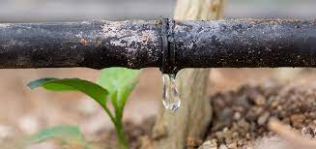
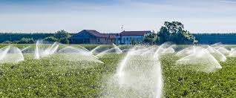
Smart Irrigation
System using IOT

Slide 2
Group Members
Name | Index
Pitiyegedara Danusha | 10820733
Sandaru Sellahannadi | 10820859
Gamlath M Gamlath | 10820892
PSM Niranjana | 10820880

Slide 3


INTRODUCTION
Smart Irrigation system.
System Functionalities
Areas that are considered ,
Sunlight
Humidity
Rain
Temperature of air
Moisture of soil
This is an ideal system for gardens and plantations.
Advantages
More accuracy
More efficiency.
Easiness of Collection and Analysis of data by using sensors.

Slide 4
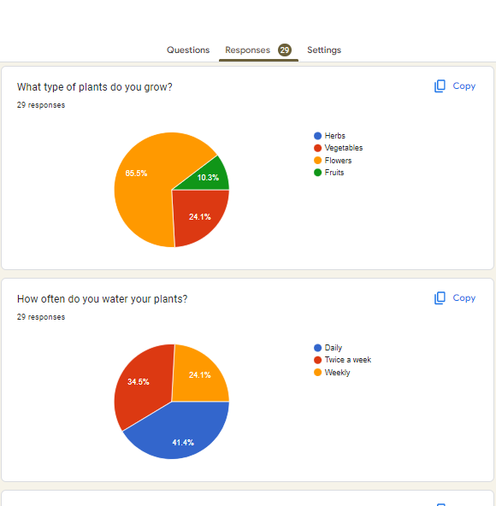
Requirement Gathering Techniques

Slide 5
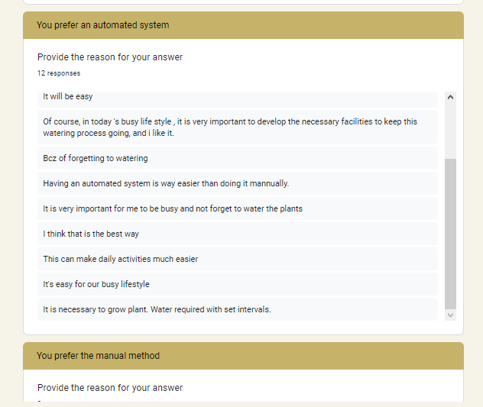

Slide 6

Goal & Objectives
Efficient irrigation and maintenance of plants.
Monitoring soil moisture, temperature, humidity and rain.
Automation to reduce workload and time.
Providing manual control in case of an error.
Enhancing the growth and health of plants.
Providing a user-friendly interface.

Slide 7
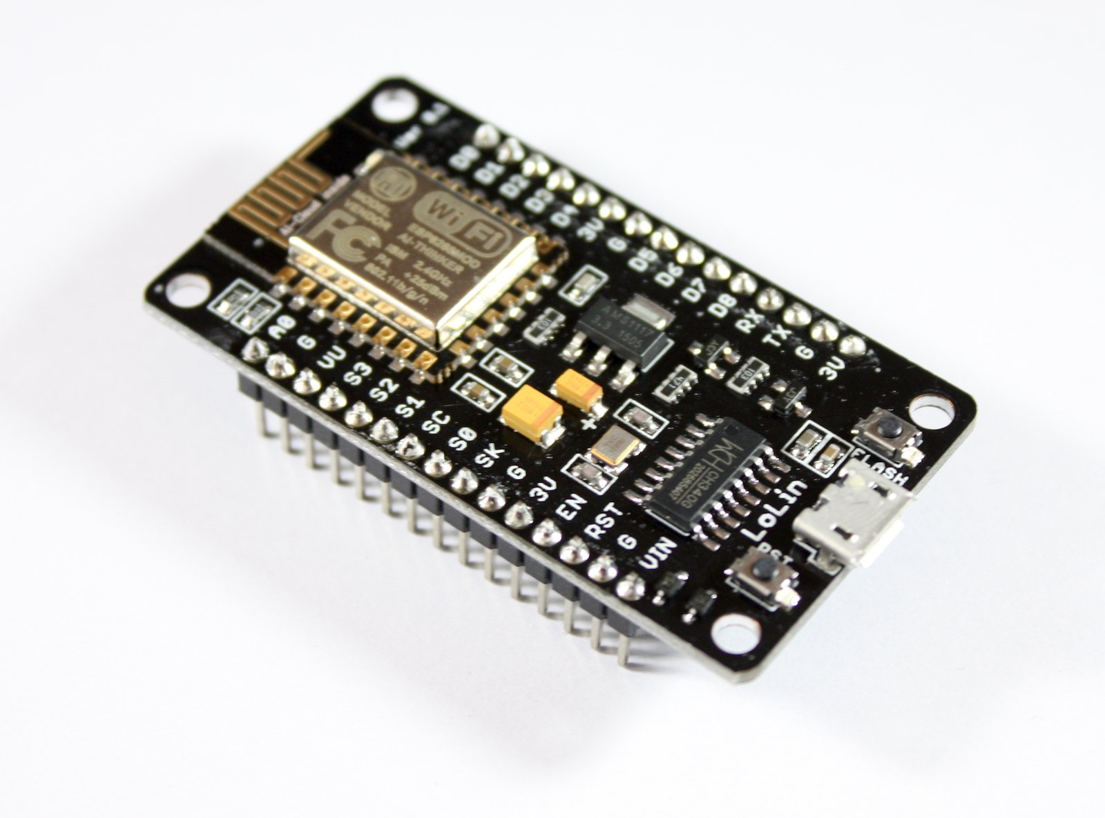
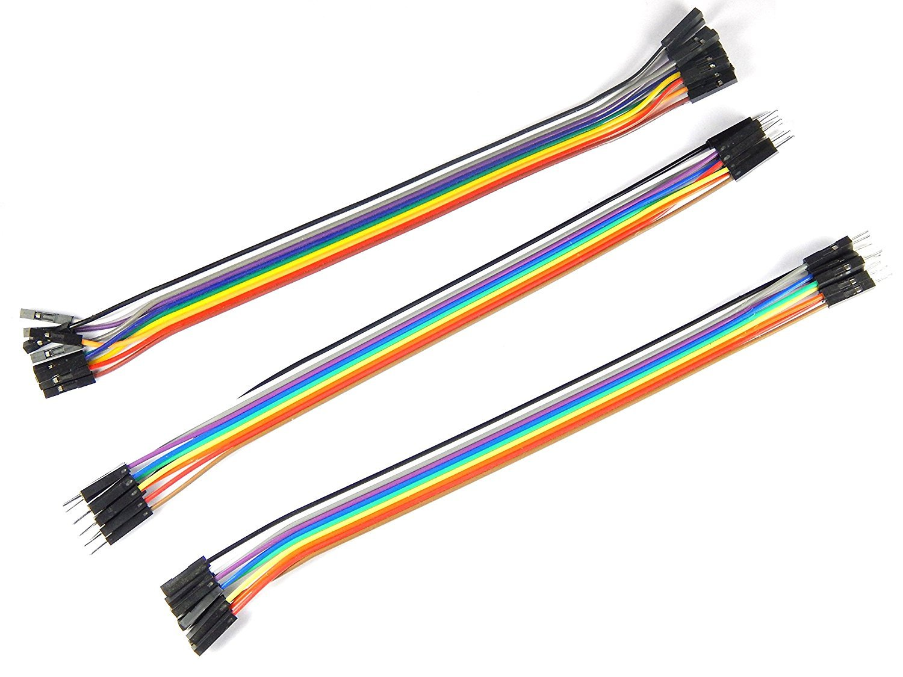
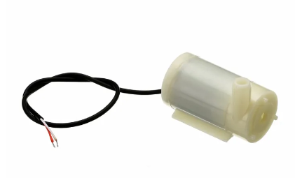
Microcontroller, Electronic Components and Output Devices
 | Name | Image | Description
Microcontroller | esp8266 NodeMCU V3 board |  | board with built-in Wi-Fi connectivity that can be programmed to control various electronic devices.
Electronic Components | Breadboard
 | Jumper Wires
 | 5V Relay Module |  | Relay module is being controlled by the NodeMCU board and it work as an electronic switch. To operate properly, it needs 5V power supply. Once powered, it can be used to turn the water pump on and off based on signals received from the NodeMCU."
Output Devices | Water Pump

Slide 8
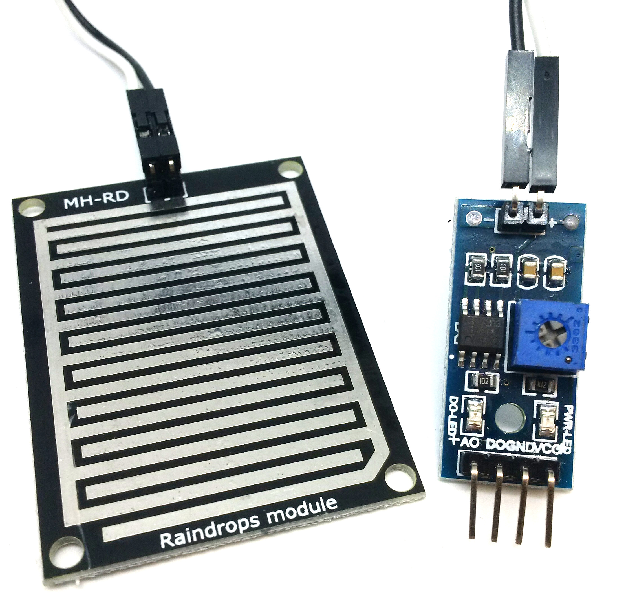
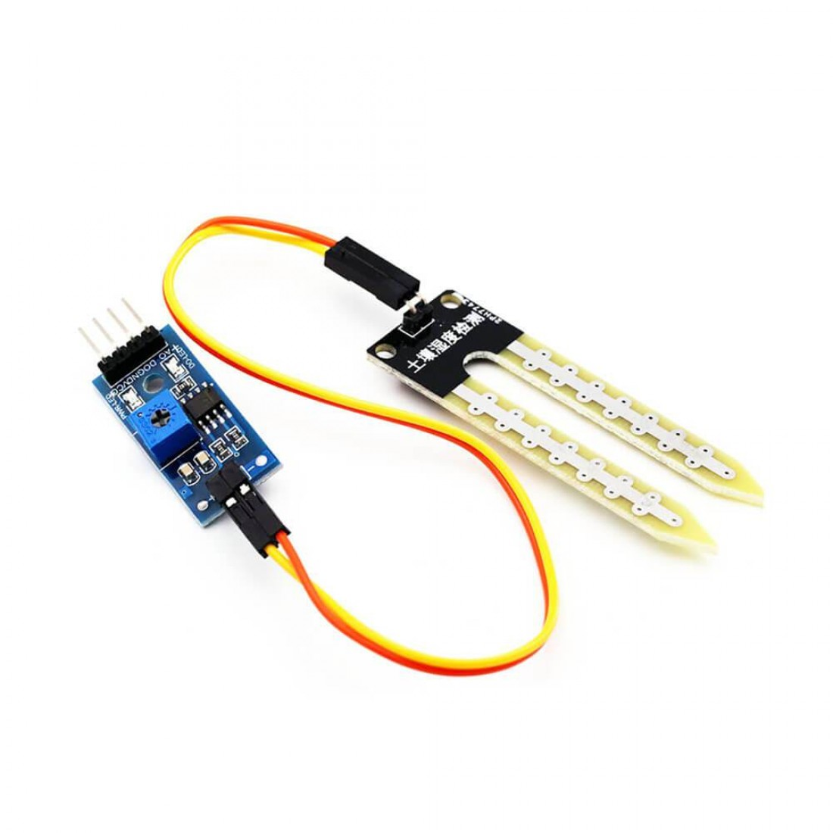
Sensors
Sensor Name | Power | Connection |  | Image | Description
DHT11–Temperature and Humidity Sensor | 3.3V to 5V | DHT11 Pin | NodeMCU Pin |  | This sensor is used to measures the temperature and relative humidity in the surrounding environment.
 |  | + - OUT | VIN G D4
Rain Drop Sensor | 3V to 5V | Rain Sensor Pin | NodeMCU Pin |  | If the water is detected, this sensor outputs a high signal to the DO pin, which can be read as a binary value of 1. When no water is detected, the sensor outputs a low signal to the DO pin, which can be read as a binary value of 0.
 |  | VCC GND DO | 3V G D8
Soil Moisture Sensor | 3V to 5V | Soil Moisture Sensor Pin | NodeMCU Pin |  | This sensor is used to measure the moisture level of the soil. We map the analog output value from a range of 0-1023 to a range of 0-100. Where 0 represents completely dry soil and 100 represents fully saturated soil.
 |  | VCC GND AO | 3V G AO

Slide 9
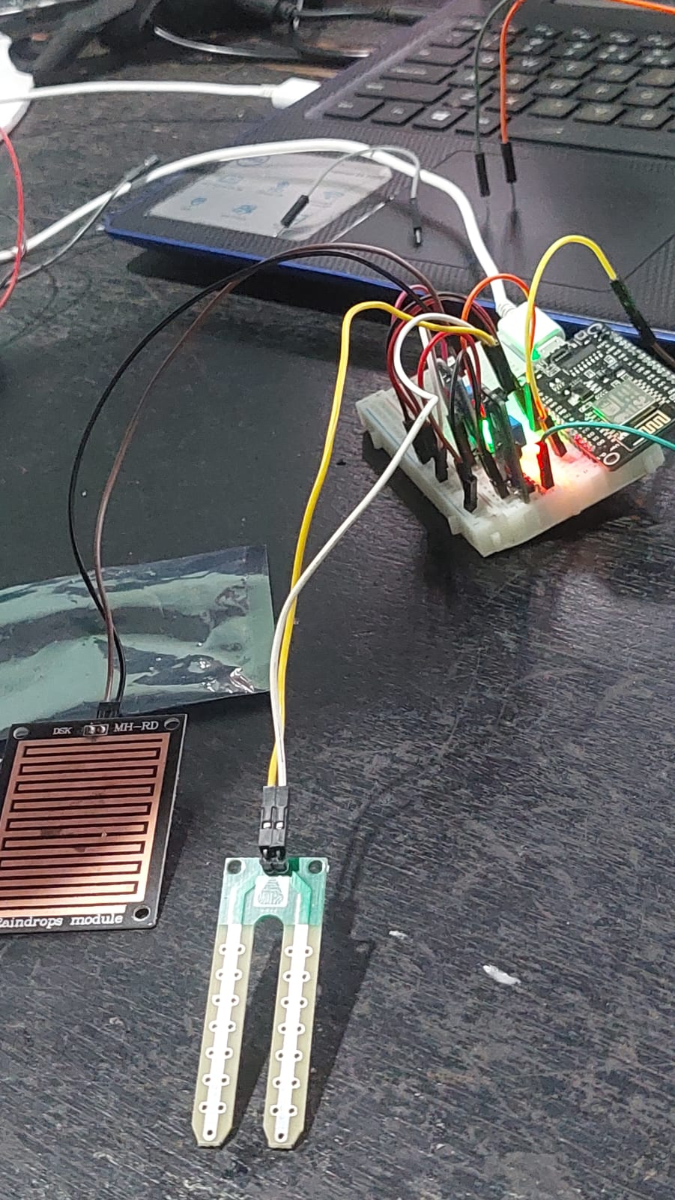
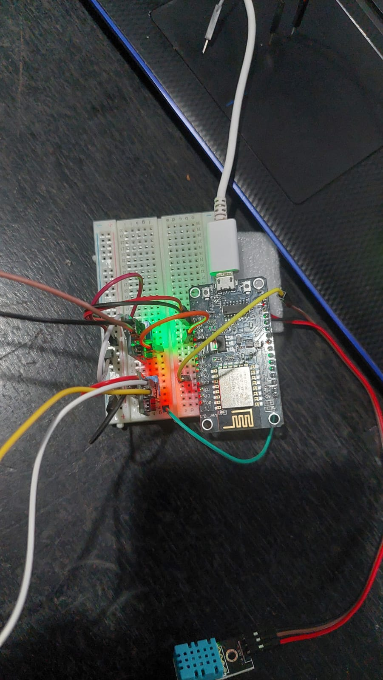
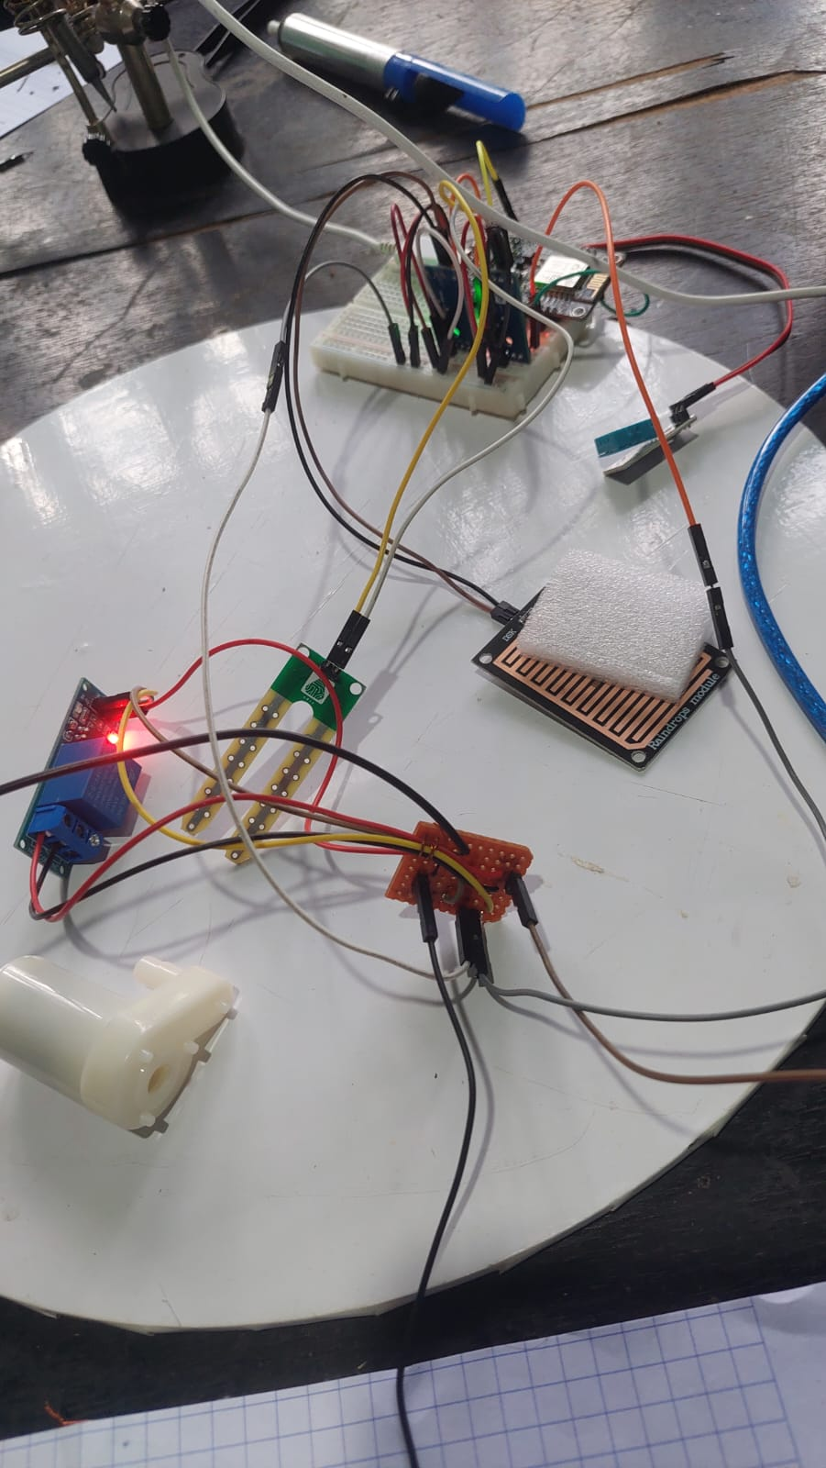
Connection

Slide 10


Arduino IDE and Firebase
Read sensor Data and Sending to the Firebase Realtime Database.

Slide 11
Web Application
By using JSP We created a Web application to display the real-time sensor values and see how the historical values will get changed.

